Slide 1
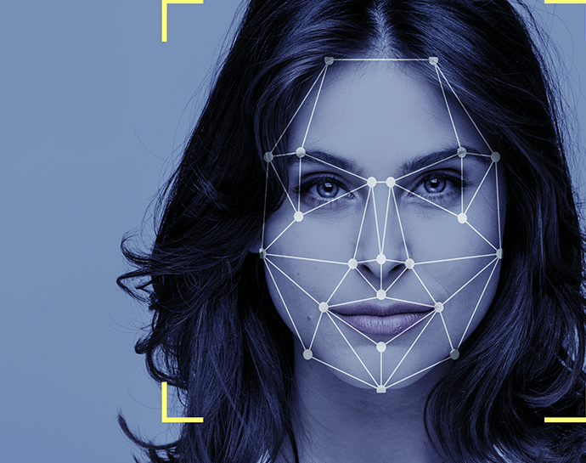
AttendanceEye A Computer Vision Attendance System
By:
Mohsin Ali Mirza – 20k-0353
Waleed Gul – 20k-0259
Mehwish Sameer- 20k - 1085

Slide 2
Acknowledgement
Dr Muhammad Waqas (Supervisor)
Dr Muhammad Rafi (Co-Supervisor)

Slide 3







Table Of Contents
Introduction
Main Goals
Objectives
Methodology
Scope Of The Project
Timeline
Literature Review

Slide 4
Introduction
Efficient Computer Vision Attendance System for Students Of Fast University
Utilizes Facial Detection and Recognition
Multiple Cameras on Gate Capture User Images
Successful Verification Grants Premises Access

Slide 5
Main Goals
Efficient Face Recognition System
Integration with Hardware
Benchmark Dataset Creation
Notes:
Develop an efficient face recognition system tailored for Fast University students.
Seamlessly integrate the face recognition system with hardware, enabling user entry control through a green LED light signal.
Establish a benchmark dataset to facilitate future research, fostering exploration and advancement in the field of facial recognition.

Slide 6

Previous Methods
Fingerprint
Unhygienic
Covid 19
Manual Data Entry
Time Consuming
Human Error
Retina Scan
Irritating
Multiple Tries

Slide 7
Objectives
Facial Data Collection
Automated Face Detection
Visual Face Verification
Automated Attendance
Minimizing Human Error
Real-World testing Environment

Slide 8
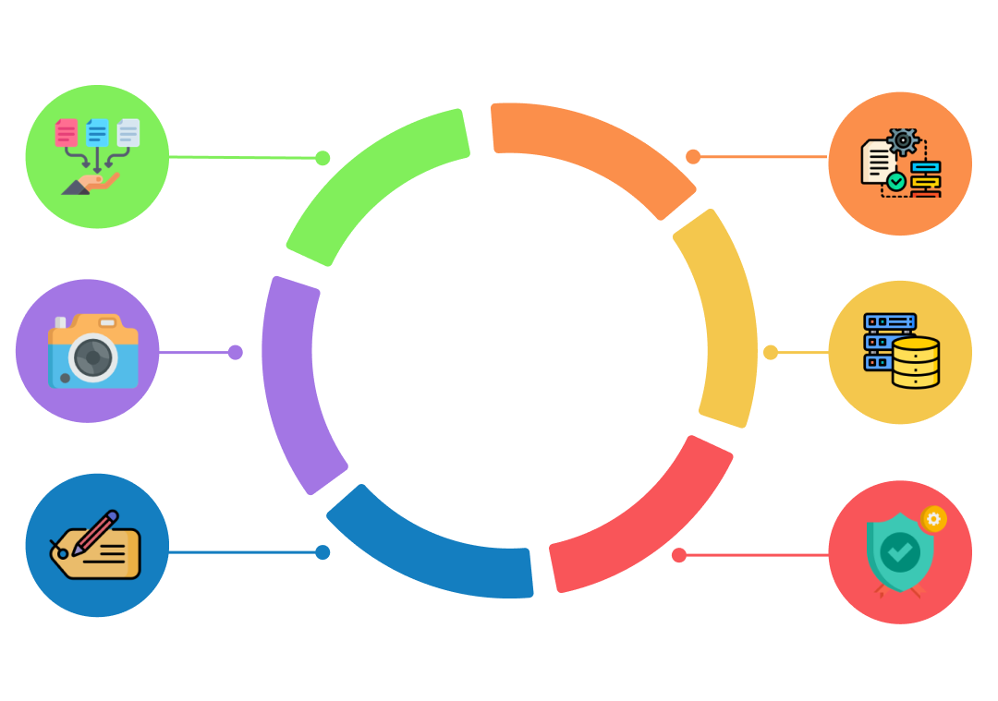
Data Collection
1: Permission Acquisition
4: Preprocessing
Conduct a survey among
FAST students to obtain
consent for photographing
them.
Apply preprocessing
techniques to enhance
image quality and
consistency.
2: Image Capture
5: Data Storage
Capture facial images of
FAST students who have
provided consent.
Store the annotated images
in a secure database such as
Firebase or Google Drive.
3: Labelling
.
6: Quality Assurance
Check for data impurities;
if identified, return to
step 2 for image recapture
Label each image in the
dataset for
identification and categorization

Slide 9
Importance For Collecting Our Own Dataset
Representation of South Asian Faces
Relevance to Our Research
Specific Age Group Focus
Ensuring Data Quality
Benchmark for Future Research
Notes:
Existing datasets lack South Asian facial data, making our dataset valuable for underrepresented populations. Pre-existing datasets often contain celebrity faces, which differ significantly from the facial characteristics of our target population, Pakistani students. Concentrating on the 19-25 age group ensures dataset relevance to our attendance system's target users. Creating our dataset allows for precise data collection, ensuring dataset cleanliness and accuracy. Our dataset can serve as a benchmark for future researchers, aiding exploration and development in the field.

Slide 10
Scope Of The Project
Limited to ideal lighting conditions
Strict face visibility
Exclusion of caps
Absence of liveness detection
Profile view requirement

Slide 11
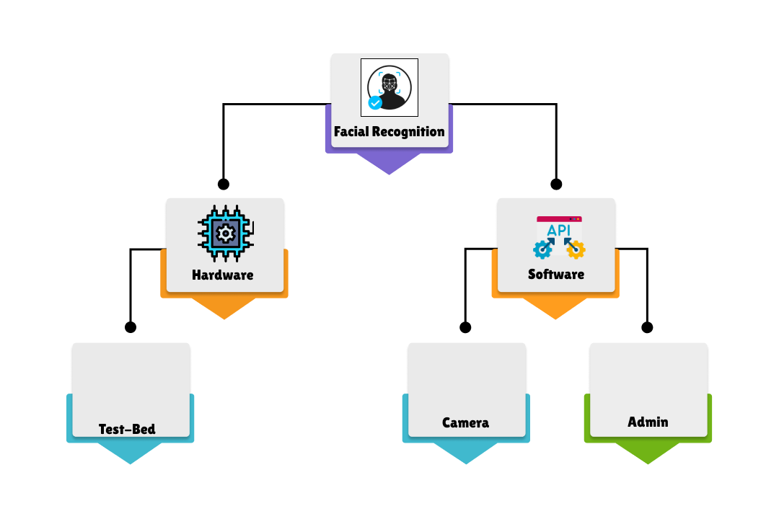
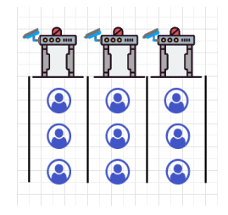
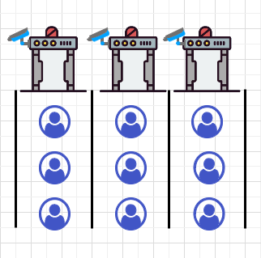
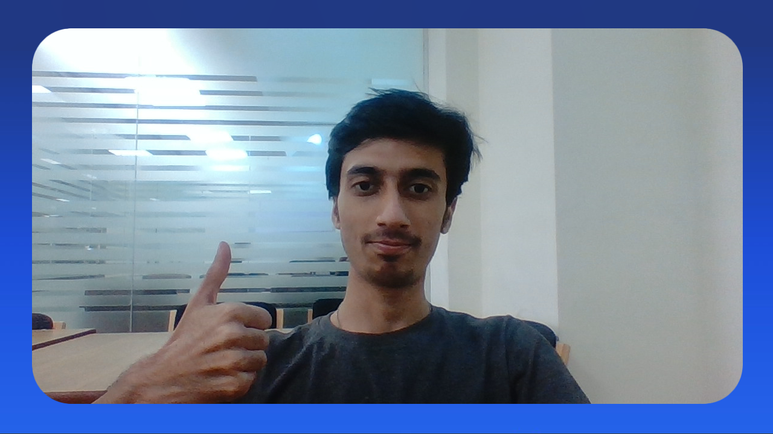
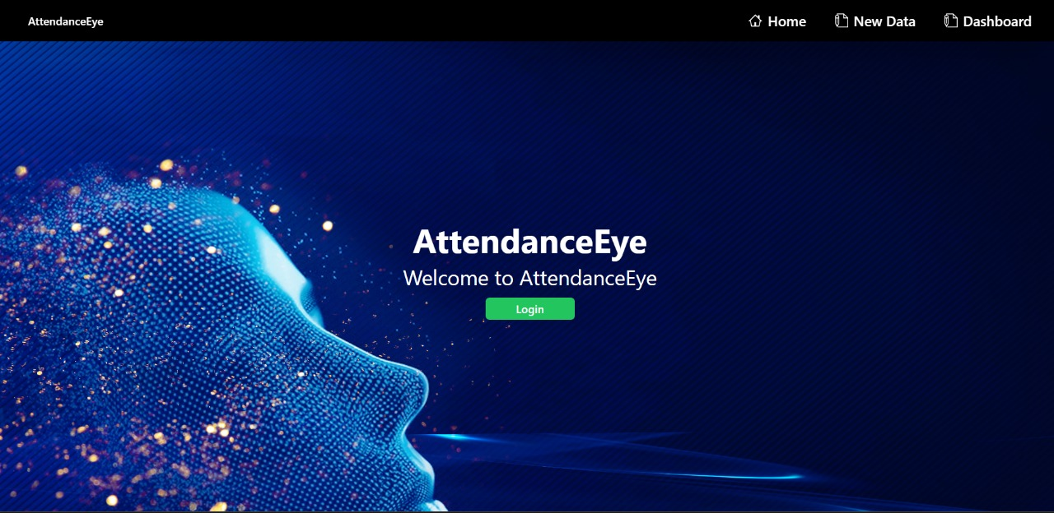
Methodology

Slide 12


Methodology – Facial Recognition

Slide 13
Methodology

Slide 14
Methodology – Test Bed
Three designated lanes for users awaiting attendance marking.
Sequential user placement in front of a camera situated atop a metal gate.
Camera captures a picture/frame for verification.
Verification against the company's employee database.
Successful verification triggers illumination of a green LED light.
Green LED light signals permission for user entry into the building.

Slide 15
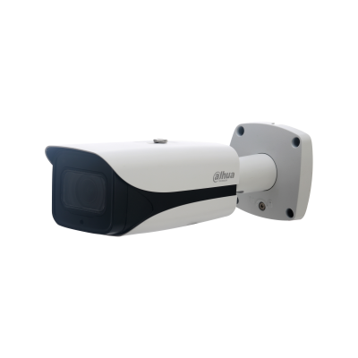
Methodology – Test Bed
Three designated lanes for users awaiting attendance marking.
Sequential user placement in front of a camera situated atop a metal gate.
Camera captures a picture/frame for verification.
Verification against the company's employee database.
Successful verification triggers illumination of a green LED light.
Green LED light signals permission for user entry into the building.
Dahua HFW5631EP-ZE Eco Savvy 3.0 Bullet IP Camera 6MP 2.7mm ~13.5mm motorized lens

Slide 16
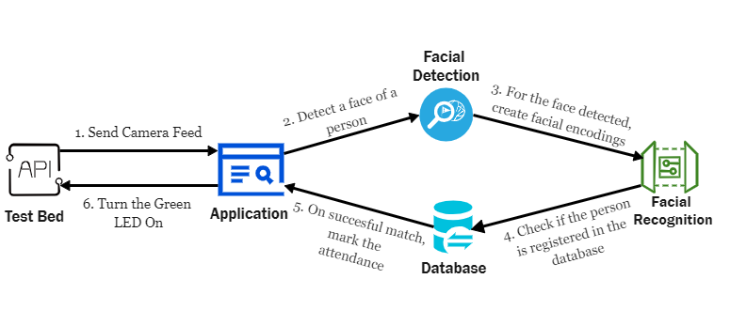
Methodology – Test Bed

Slide 17
Methodology

Slide 18


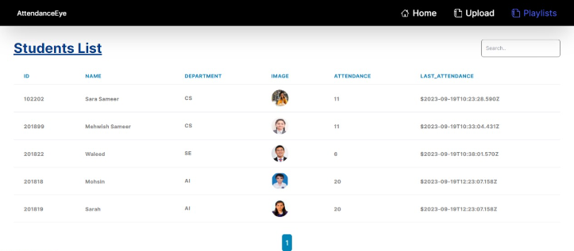


Methodology - Admin

Slide 19
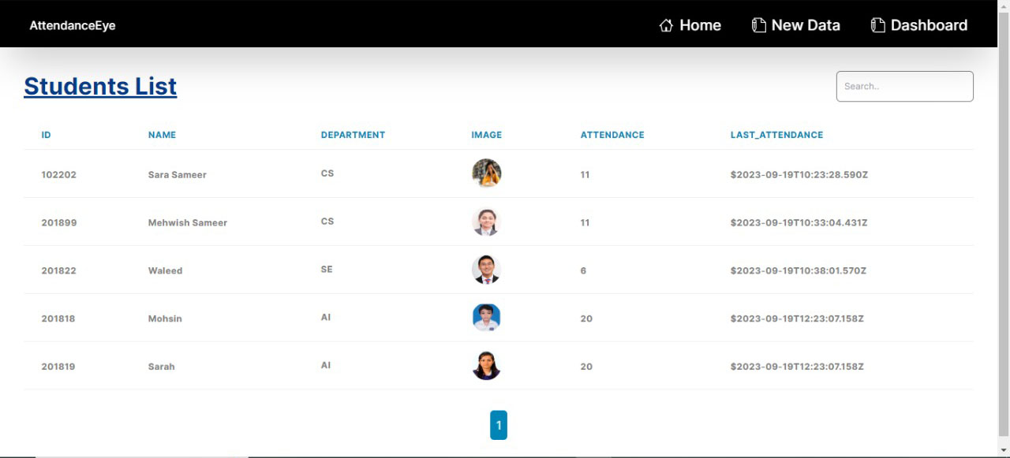

Methodology - Admin

Slide 20
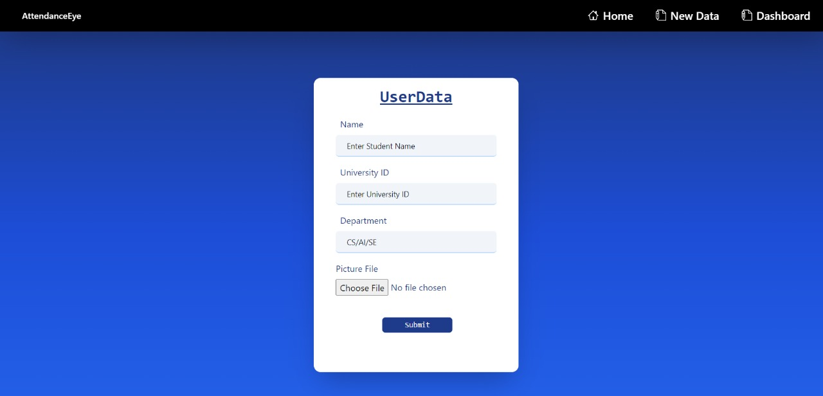
Methodology - Admin

Slide 21
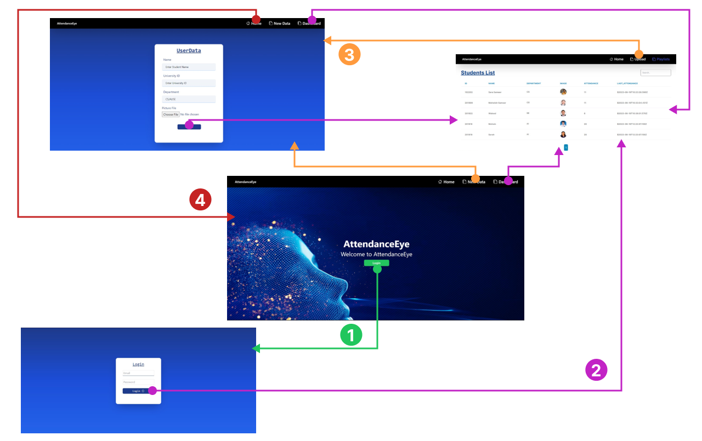
Methodology

Slide 22

Methodology - Admin

Slide 23
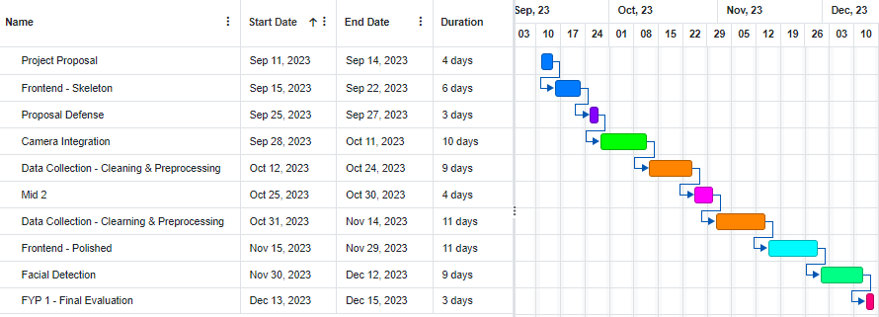
Timeline – FYP 1

Slide 24
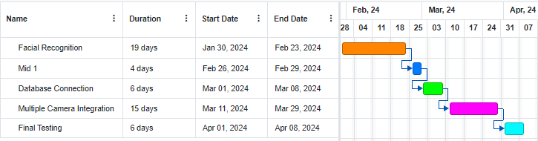
Timeline – FYP 2

Slide 25
Literature Review
Optimizing Face Recognition Inference with a Collaborative Edge–Cloud Network – [2022]
Implemented MTCNN for face detection
Used Dlib for face recognition
Browser and cloud were used.
A Literature Review on Smart Attendance Systems – [2022]
Used camera to detect and recognize faces
Marked attendance in database
YOLO-face: a real-time face detector – [2021]
Used modified version of YOLOv3
Different sizes of anchor boxes
Real Time Automatic Attendance System for Face Recognition – [2020]
Used Yolov3
Face API
Microsoft Azure

Slide 26

Any Questions?

Slide 27


